Slide 1

Elasticsearch
Chao Li

Slide 2

Lesson 1
Notes:
Kafka

Slide 3
Outline
Basic introduction to Elasticsearch
Scrapy - A Python scraper framework
Elasticsearch persistence

Slide 4
Basic introduction to Elasticsearch

Slide 5
Search Engine
Search documents for keywords
Return matching results in some order
Web search engine

Slide 6
Elasticsearch
Elasticsearch is an open-source, broadly-distributable, readily-scalable, enterprise-grade search engine. Accessible through an extensive and elaborate API, Elasticsearch can power extremely fast searches that support your data discovery applications.

Slide 7
Let’s get started with some APIs

Slide 8
Document APIs
curl -XPUT 'localhost:9200/starter/simple/1?pretty' -d' { "user" : "username", "message" : "trying out Elasticsearch" } '
curl -XGET 'localhost:9200/starter/simple/1?pretty'
curl -XDELETE 'http://localhost:9200/starter/simple/1?pretty'
Domain Specific Language

Slide 9
Document APIs
curl -XPUT 'localhost:9200/starter/simple/1?pretty' -d' "counter" : 1, "tags" : ["red"] } ‘

Slide 10
Search APIs
URI search
curl -XGET 'localhost:9200/starter/_search?q=tags:red&pretty'
query body search
curl -XGET 'localhost:9200/_search?pretty' -d' { "query" : { "term" : { "red" : "pretty" } } } '

Slide 11
Search APIs
Highlight Query
curl -XGET 'localhost:9200/_search?pretty' -d' { "query" : { "match": { "tags": "red" } }, "highlight" : { "fields" : { "tags" : {} } } } '

Slide 12
Cluster APIs
Cluster Health
curl -XGET 'localhost:9200/_cluster/health?pretty'

Slide 13
Scrapy

Slide 14
Basic usage of Scrapy
Installation
scrapy shell
xpath
spiders
pipline

Slide 15
Index
Index is the place where we store data
Index points to physical shards, which is a single instance of Lucene
Shards are distributed among clusters
Elasticsearch maintains the balance of shards among nodes while scale-out and scale-in
Shards could be primary or replica

Slide 16
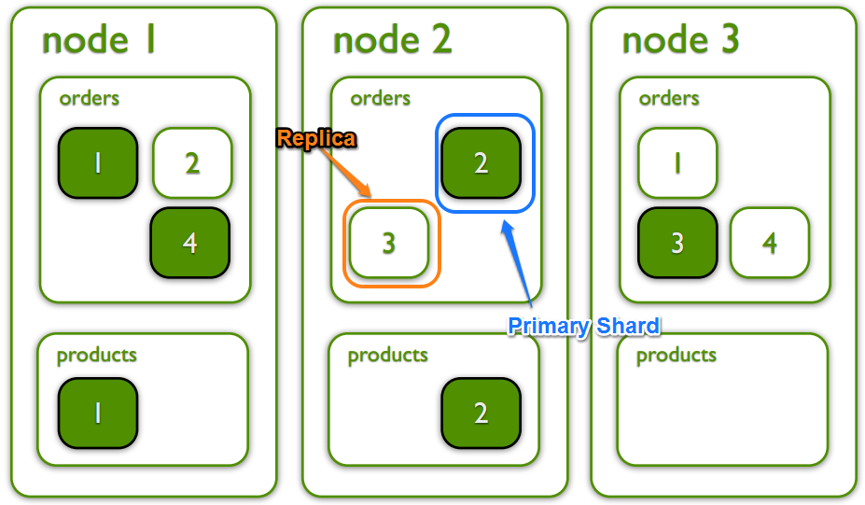
Index
Index is the place where we store data
Index points to physical shards, which is a single instance of Lucene
Shards are distributed among clusters
Elasticsearch maintains the balance of shards among nodes while scale-out and scale-in
Shards could be primary or replica

Slide 17
How does documents got stored
curl -XPUT 'localhost:9200/starter/simple/1?pretty' -d' "message": "This is a cat" } '
curl -XPUT 'localhost:9200/starter/simple/1?pretty' -d' "message": "This is a dog" } '
Term doc_1 doc_2
This x x
is x x
a x x
cat x
dog x

Slide 18
Mapping and Analysis
curl -XGET 'localhost:9200/starter/_mapping/simple?pretty'

Slide 19
Mapping and Analysis
Elasticsearch creates mappings based on the value of documents passed in
To take full advantage of elasticsearch we create mappings manually

Slide 20
Analyzer
Tokenizer
Letter tokenizer
lowercase tokenizer
etc.
Token filters
lowercase token filter
ngram token filter
etc.
Character filters
Mapping char filter, etc.

Slide 21
Analyzer
curl -XPOST 'localhost:9200/_analyze?pretty' -d' { "analyzer": "whitespace", "text": "The quick brown fox." } ' curl -XPOST 'localhost:9200/_analyze?pretty' -d' { "tokenizer": "standard", "filter": [ "lowercase", "asciifolding" ], "text": "Is this déja vu?" } '

Slide 22
Mapping and Analysis
curl -XPUT 'localhost:9200/starter?pretty' -d' { "mappings": { "simple": { "properties": { "message": { "type": "keyword" } } } } } '

Slide 23
elasticsearch-dsl-py

Slide 24
Why elasticsearch-dsl-py
Query body is vulnerable
It’s hard to create complex query

Slide 25
Let’s get started

Slide 26


课程项目负责人：Angela
邮件：angela@bittiger.io
微信二维码：
关注微信，获得太阁最新信息
微信: bit_tiger
官网: BitTiger.io
https://github.com/chaopli/imdb-scraper-incomplete

